Slide 1
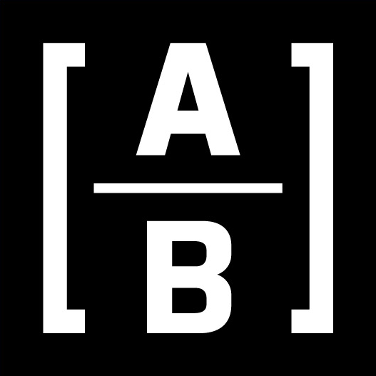
Portfolio Construction
Team 2
George Lyu, Samantha Armijo, Jiayu Shi, Sruthi Pappu, and Franck Brych

Slide 2
Agenda
Data PreProcessing
EDA / Yahoo API
GPT Model
RNN Model
BERT / FinBERT Model
AlphaLens / BackTesting
Portfolio
What’s the business problem?
Why is it important for the business?
What is the specific goal of the project?

Slide 3





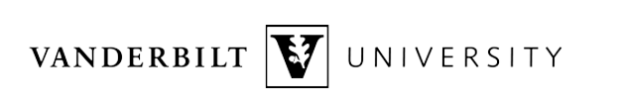
Data PreProcessing
The Challenge
Our Approach
Original dataset was ESG sentiment analysis
ChatGPT relabeled all rows
Sort new dataset by Date
Train: 2022 data
Test: 2023 data
What’s the business problem?
Why is it important for the business?
What is the specific goal of the project?
What’s the business problem?
Why is it important for the business?
What is the specific goal of the project?
Notes:
Original dataset was ESG sentiment analysis and this is out of our range so our solution
was to use ChatGPT to relabel all rows
In ChatGPT we gave it Summary, Description, Ticker, and Adjusted Date where date was adjusted if the published date was after 4pm EST (since market closes at this time) so we added +1 date
After ChatGPT relabeled all the rows positive, negative, or neutral we sorted the dataset by date and into two files
Train: 2022 data
Test: 2023 data
We also did a sanity check and spot checked some labels that were ChatGPT labeled.

Slide 4
Agenda
Data PreProcessing
EDA / Yahoo API
GPT Model
RNN Model
BERT / FinBERT Model
AlphaLens / BackTesting
Portfolio
What’s the business problem?
Why is it important for the business?
What is the specific goal of the project?

Slide 5
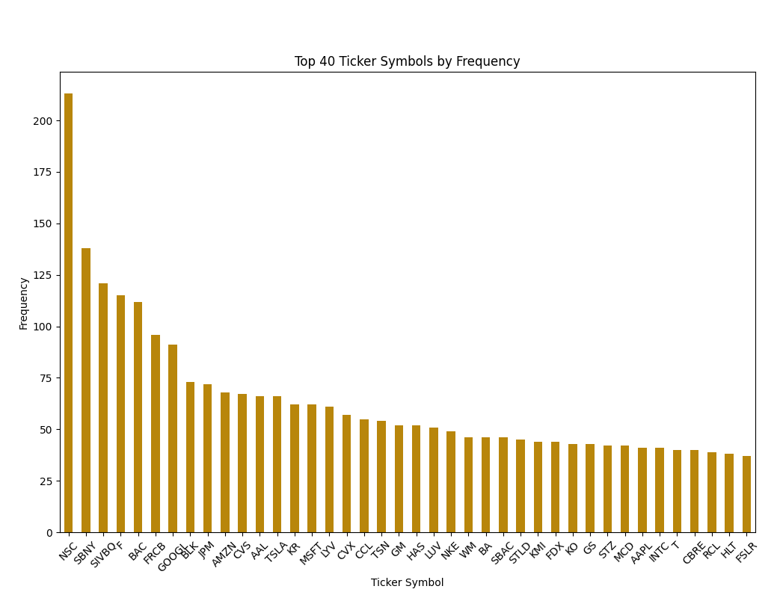
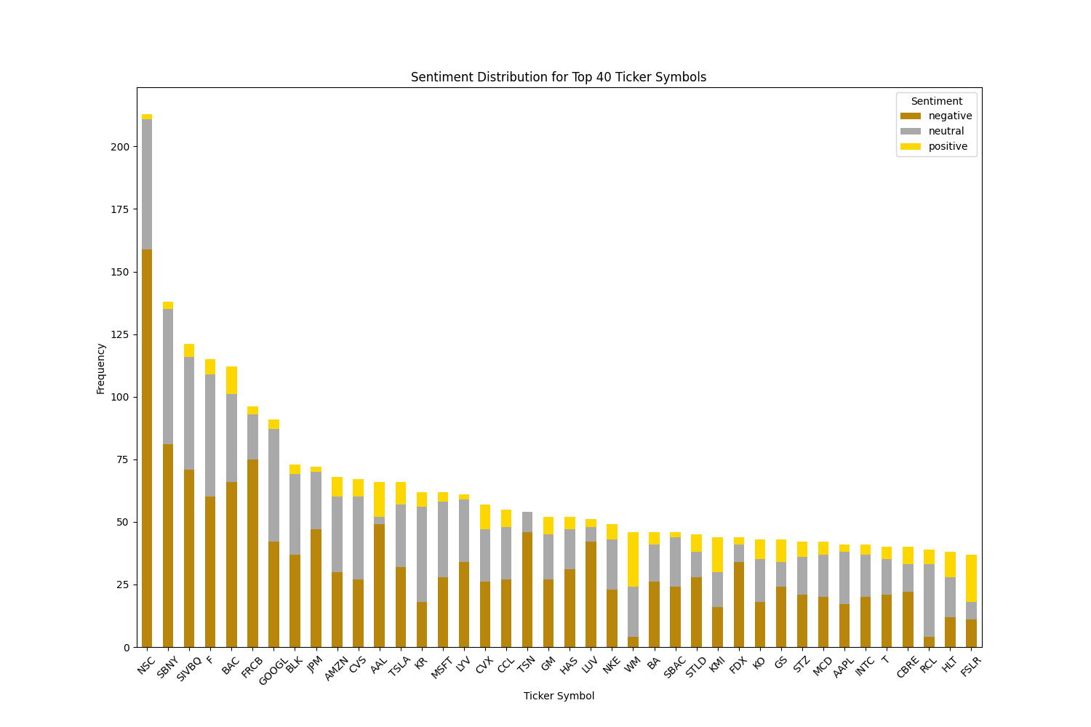
EDA / Yahoo API
What’s the business problem?
Why is it important for the business?
What is the specific goal of the project?
Notes:
Some initial EDA was a breakdown of how freq we saw Tickers. As we can see there is an imbalance of how many articles there are on the companies. We wanted to then see of the frequency how many were positive, negative, or neutral. Once again we see there is an imbalance and there is more negative sentiment label from ChatGPT labels. This is just a visual representation of the top 40 tickers but we did not just focus on these companies.

Slide 6
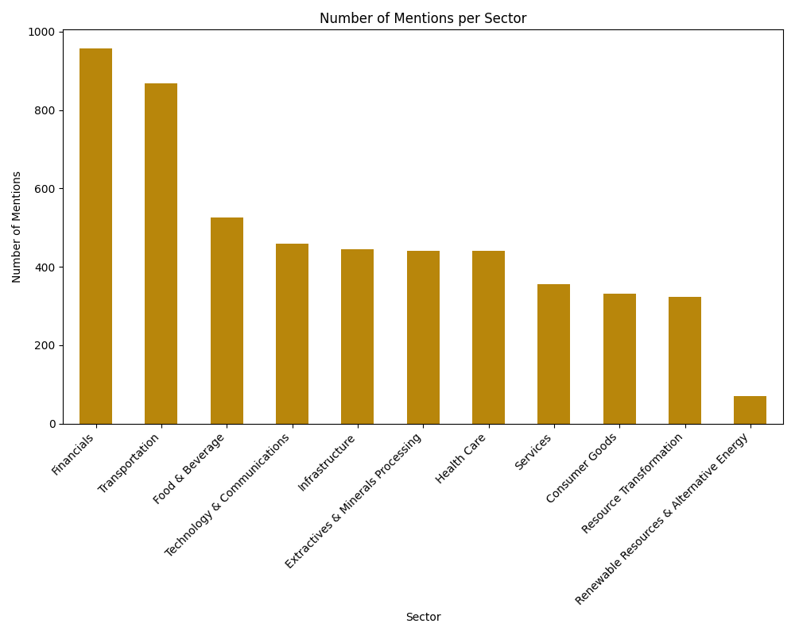
EDA / Yahoo API
What’s the business problem?
Why is it important for the business?
What is the specific goal of the project?
Notes:
Finally, we also did a breakdown of the the number of mentions by sector and can conclude again there is an imbalanced.

Slide 7
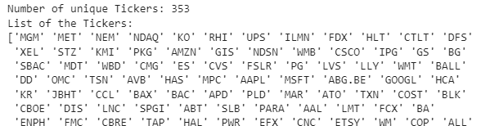
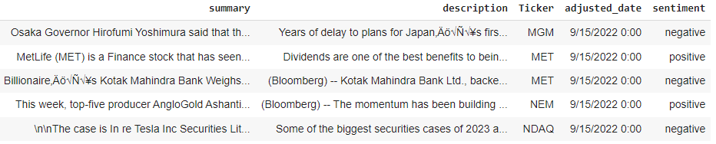
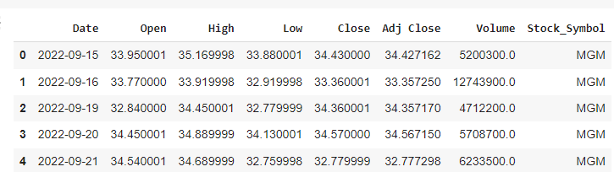
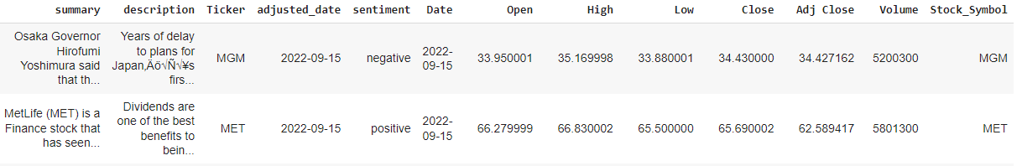
EDA / Yahoo API
Used adjusted date dataset to pull stock information using the Yahoo Finance API
Identified the unique tickers relevant to our analysis
Used the API to pull stock information on our desired Tickers and merged data (ChatGPT labels + stock data)
+
Notes:
After labelling the rows using chatGPT -> used yahoo finance API to get the desired tickers

Slide 8
Agenda
Data PreProcessing
EDA / Yahoo API
GPT Model
RNN Model
BERT / FinBERT Model
AlphaLens / BackTesting
Portfolio
What’s the business problem?
Why is it important for the business?
What is the specific goal of the project?

Slide 9
GPT Model
Purpose:
Used the GPT-3.5 to analyze the sentiment of text data.
Classified the data as positive, negative, or neutral.
Data Handling:
Split the data into two sets: 80% for training and 20% for testing.
Sentiment Analysis Function:
The text was sent to GPT-3.5 to perform sentiment analysis (positive, negative, or neutral).
Evaluating Accuracy:
Compared GPT-3.5’s sentiment predictions with the actual labels from the dataset.
It calculated the accuracy of the model, which reflects how often GPT-3.5’s predictions were correct.
Results
When compared with the sentiment provided in the data set, the model provided an accuracy of 37%
What’s the business problem?
Why is it important for the business?
What is the specific goal of the project?

Slide 10
Agenda
Data PreProcessing
EDA / Yahoo API
GPT Model
RNN Model
BERT / FinBERT Model
AlphaLens / BackTesting
Portfolio
What’s the business problem?
Why is it important for the business?
What is the specific goal of the project?

Slide 11
RNN Model
Preprocessing:
Converted categorical sentiment labels to numerical values using LabelEncoder.
Tokenized the summary, limiting to a maximum of 5000 words.
Converted the tokenized texts into sequences and padded them to a uniform length.
Model:
A Sequential RNN model was built using Keras which includes an Embedding layer, an LSTM layer with dropout and recurrent dropout for regularization, and a Dense output layer with softmax activation.
L2 regularization was used in the LSTM layer to prevent overfitting.
K-Fold Cross-Validation:
Used 5-fold cross-validation for training, improving the robustness of the model.
In each fold, the model was compiled, trained, and evaluated.
Training:
The model was trained with a batch size of 32 and for 10 epochs and the training loss and accuracy were tracked.
Evaluation:
After training, the model was evaluated on a separate testing dataset.
Reporting Results:
The final accuracy of the model is 68.32%
What’s the business problem?
Why is it important for the business?
What is the specific goal of the project?

Slide 12
Agenda
Data PreProcessing
EDA / Yahoo API
GPT Model
RNN Model
BERT / FinBERT Model
AlphaLens / BackTesting
Portfolio
What’s the business problem?
Why is it important for the business?
What is the specific goal of the project?

Slide 13
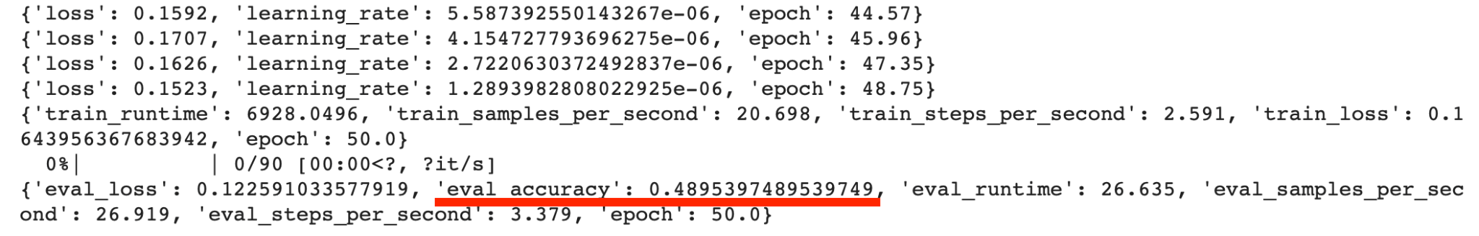
BERT Model
Sentiment Distribution: The dataset comprises 1801 negative, 948 neutral, and 836 positive articles.
Dataset Split: Allocated 80% for training and 20% for testing.
Model Choice: Utilized BERT (bert-base-uncased) for sequence classification, targeting 3 sentiment classes.
Full Model Fine-Tuning: Engaged all 109,484,547 parameters over 3 epochs, achieving a 39% accuracy.
Selective Fine-Tuning: Adjusted only the last layer, involving 2,307 parameters across 100 epochs, resulting in a 49% accuracy.

Slide 14
BERT Model
The potential reasons for the low accuracy:
Token Length Constraint: BERT-Base, Uncased supports up to 512 tokens, whereas the average article length in the dataset is 3,379 words, indicating a potential limitation in processing full articles.
Data Quality Concerns: The training dataset may lack high quality, impacting model performance.

Slide 15
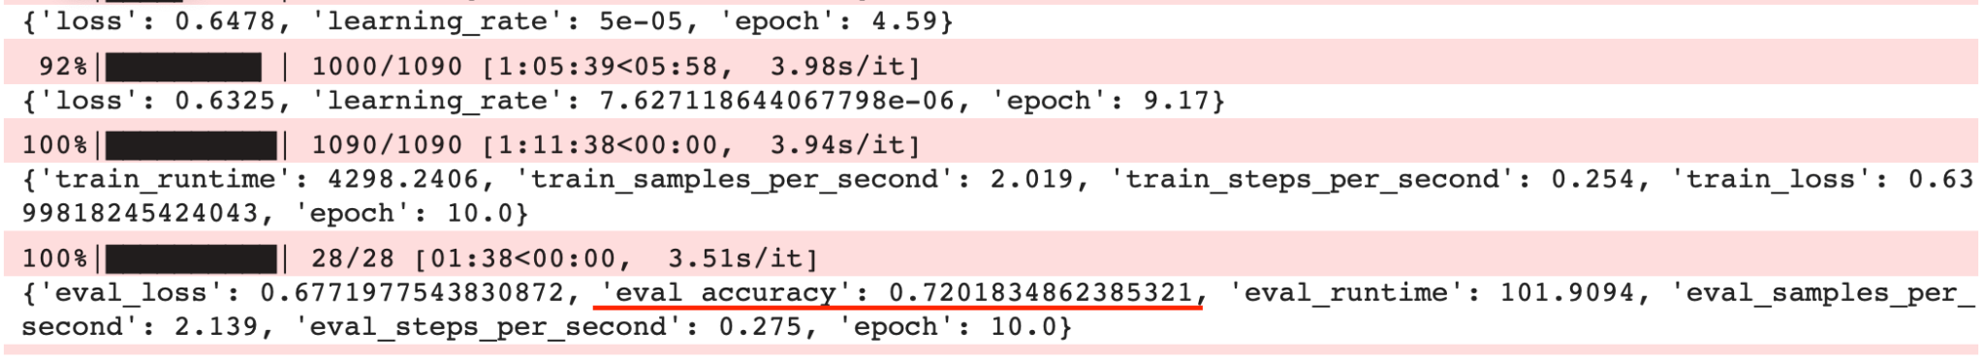
FinBERT Model
Data Preparation: Utilized 4 months of data from 2022 for fine-tuning and all 2023 data for predictions.
Sentiment Ground Truth: Employed ChatGPT-generated sentiment as the ground truth for fine-tuning.
Model Selection: Chose FinBERT (ProsusAI/finbert) for sentiment analysis, focusing on three classes.
Initial Fine-Tuning: Targeted the classifier layer with 2,307 parameters over 10 epochs, achieving 72% accuracy.
Advanced Fine-Tuning: Expanded to fine-tune both pooler and classifier layers, totaling 592,899 parameters over 10 epochs, maintaining 72% accuracy.

Slide 16
FinBERT Model
High Accuracy Factors: Enhanced performance owing to limited truncation, as article summaries generally fell within FinBERT's maximum token length.
Pre-trained Advantage: FinBERT's prior fine-tuning on an extensive financial dataset contributed to the high accuracy.

Slide 17
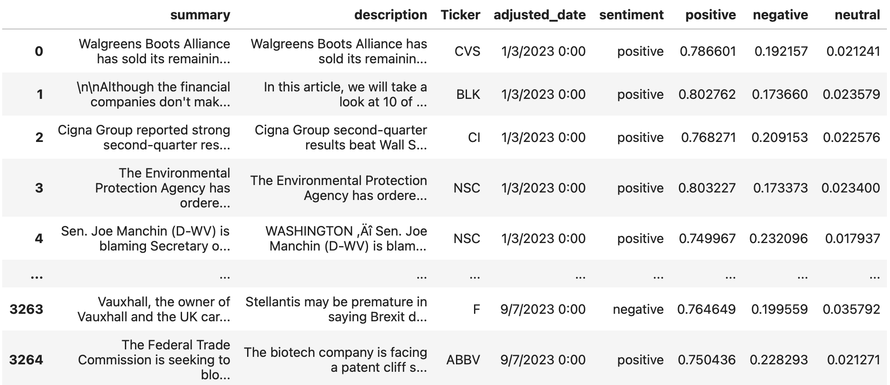
FinBERT Model

Slide 18
Agenda
Data PreProcessing
EDA / Yahoo API
GPT Model
RNN Model
BERT / FinBERT Model
AlphaLens / BackTesting
Portfolio
What’s the business problem?
Why is it important for the business?
What is the specific goal of the project?

Slide 19
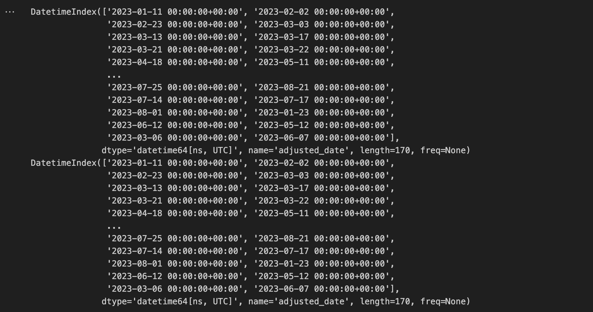
AlphaLens / BackTesting
Backtesting (Long/Short Strategy for Finding Portfolios)
AlphaLens Package for Predefined Strategy Getting Best Portfolios
Parameters: Factor and Price
Error: “TypeError: incompatible index of inserted column with frame index”
What’s the business problem?
Why is it important for the business?
What is the specific goal of the project?

Slide 20
Agenda
Data PreProcessing
EDA / Yahoo API
GPT Model
RNN Model
BERT / FinBERT Model
AlphaLens / BackTesting
Portfolio
What’s the business problem?
Why is it important for the business?
What is the specific goal of the project?

Slide 21
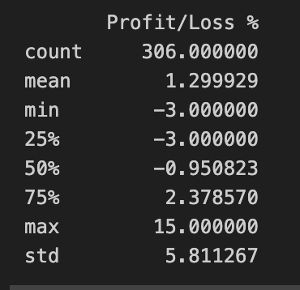
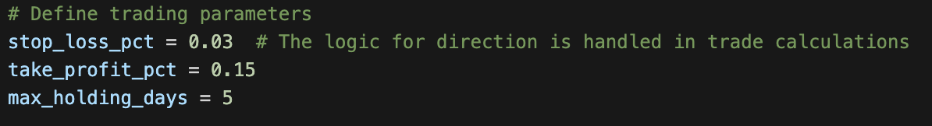
Portfolio
We designed a strategy with the following rules:
3% stop loss on every trade
15% take profit on every trade
A maximum holding period of 5 days
What’s the business problem?
Why is it important for the business?
What is the specific goal of the project?
Notes:
Played around with stop loss and holding days, and saw that 2.5% stop loss could be better.
score pos higher 0.77
neg higher 0.28

Slide 22
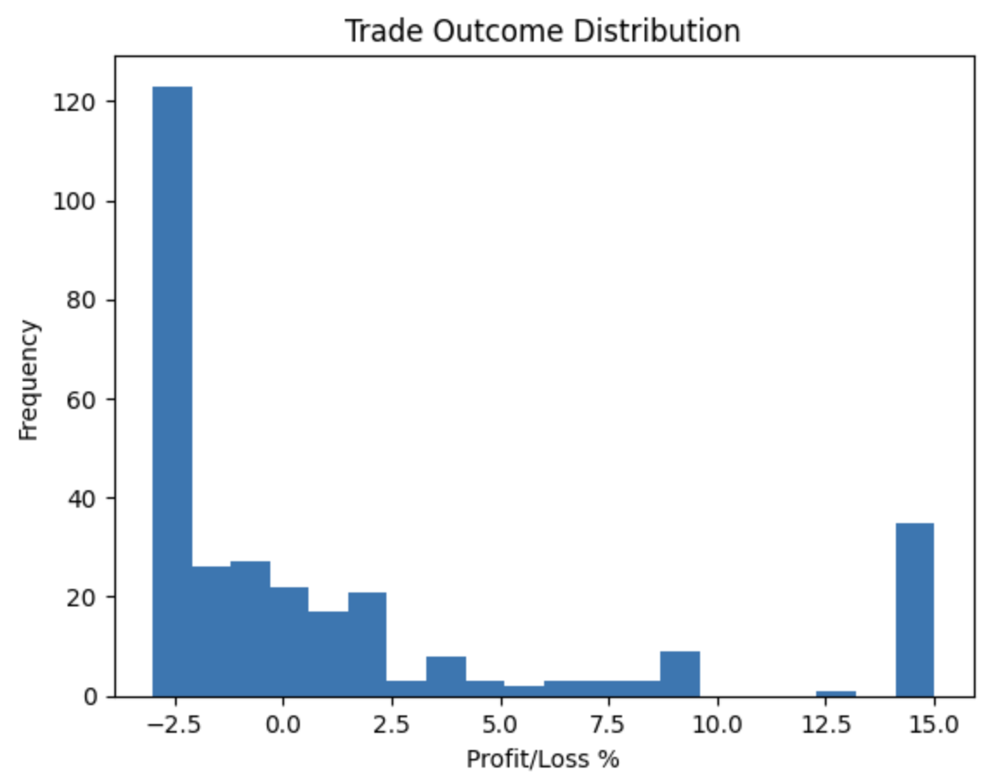
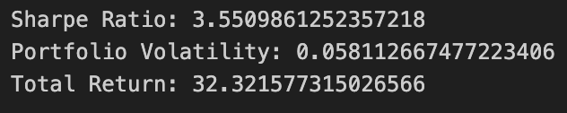
Portfolio
What’s the business problem?
Why is it important for the business?
What is the specific goal of the project?

Slide 23
Thank you!
Questions.

